Slide 1

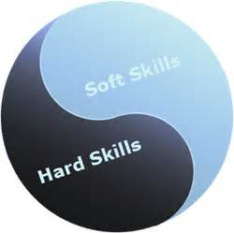
SOFT SKILLS

Slide 2
Soft skills
Interpersonal skills
People skills
Social skills
Communication skills
Character traits
Attitudes
Career attributes
Social intelligence
Emotional intelligence

Slide 3
COLLINS ENGLISH DICTIONARY
“Desirable qualities for certain forms of employment that do not depend on acquired knowledge
They include
Common sense,
The ability to deal with people,
Positive flexible attitude.”

Slide 4
HISTORY
1959 US Army felt the importance
Whitmore, Paul G., "What are soft skills?“
“Soft skills are important job-related skills that involve little or no interaction with machines and whose application on the job is quite generalized.”
It is through a 1972 US Army training manual identified formal usage of the term
"soft skills"
began

Slide 5
Soft Skills
Social graces
Communication abilities
Language skills
Personal habits
Cognitive or emotional empathy
Time management
Teamwork
Leadership traits.
soft skills as an umbrella term for skills under key three functional elements people skills, social skills and personal career attributes

Slide 6
National Business Education Association
Soft skills as critical for being industrious in today’s workplace.
Soft skills complement hard skills also known as technical skills, for productive workplace performance and everyday life competencies (Arkansas Department of Education, 2007).

Slide 7
Hard skills were the only skills necessary for career employment and were generally quantifiable and measurable from educational background, work experience or through interview.
A study conducted by Harvard University noted that 80% of achievements in career are determined by soft skills and only 20% by hard skills.
Experts say soft skills training should begin for a person when they are students, to perform efficiently in their academic environment as well as in their future workplace

Slide 8
Stanford Research Institute and the Carnegie Mellon Foundation among Fortune 500 CEOs
75% of long term job success resulted from soft skills and only 25% from technical skills
-(Sinha, 2008)
Soft skills are as important as cognitive/technical skills
-(John, 2009; Zehr, 1998).

Slide 9
List of soft skills compiled by Eastern Kentucky University
Communication – oral, speaking capability, written, presenting, listening.
Courtesy – manners, etiquette, business etiquette, gracious, says please and thank you, respectful.
Flexibility – adaptability, willing to change, lifelong learner, accepts new things, adjusts, teachable.
Integrity – honest, ethical, high morals, has personal values, does what’s right.
Interpersonal skills – nice, personable, sense of humor, friendly, nurturing, empathetic, has self-control, patient, sociability, warmth, social skills.
Positive attitude – optimistic, enthusiastic, encouraging, happy, confident.
Professionalism – businesslike, well-dressed, appearance, poised.
Responsibility – accountable, reliable, gets the job done, resourceful, self-disciplined, wants to do well, conscientious, common sense.
Teamwork – cooperative, gets along with others, agreeable, supportive, helpful, collaborative.
Work ethic – hard working, willing to work, loyal, initiative, self-motivated, on time, good attendance.

Slide 10
Importance of Soft Skills
Soft skills are important.
Some would argue that it is not hard skills that will make the big difference in the success of an organization; it’s the soft skills.
The soft skills create agile organizations, develop innovative companies, make the best places to work, and build the most admired companies.
Soft skills bring out the best in people as their behaviors and competencies are shaped to fit the strategy of the organization, the desired work climate, and the ever changing, unpredictable landscape

Slide 11
Entry level professionals not prepared for the working world, reveals survey
• 89% of the business leaders, HR directors worry about quality of future leaders • 74% say they have hired graduates who lack the necessary people skills • 77% of graduates feel ‘people skills get in the way of getting the job done’

Slide 12
Young India lacks soft skills: Survey
A survey of 303 employers across the country by the Federation of Indian Chambers of Commerce and Industry (Ficci) in 2010 found
A majority of graduates lacked adequate "soft skills" to be employed in the industry.

Slide 13
Only about one-third employers were satisfied with the communication ability of their employees and about 26 per cent with their employees' writing ability.
If this trend continues, the prospects for the 1.4 billion youth estimated to enter the work force by 2020, and consequently for the economy, look anything but promising.

Slide 14
Narendra Jadhav, Planning Commission member in-charge of education and former vice-chancellor of Pune University, agrees. "Survey after survey has shown that 33 per cent of our graduates are unemployable," he said.
"The quality of teaching on our campuses is outdated. They do not follow the latest market demands. Added to that is the student's level of learning, but most crucial is the lack of communication skills," he added.

Slide 15
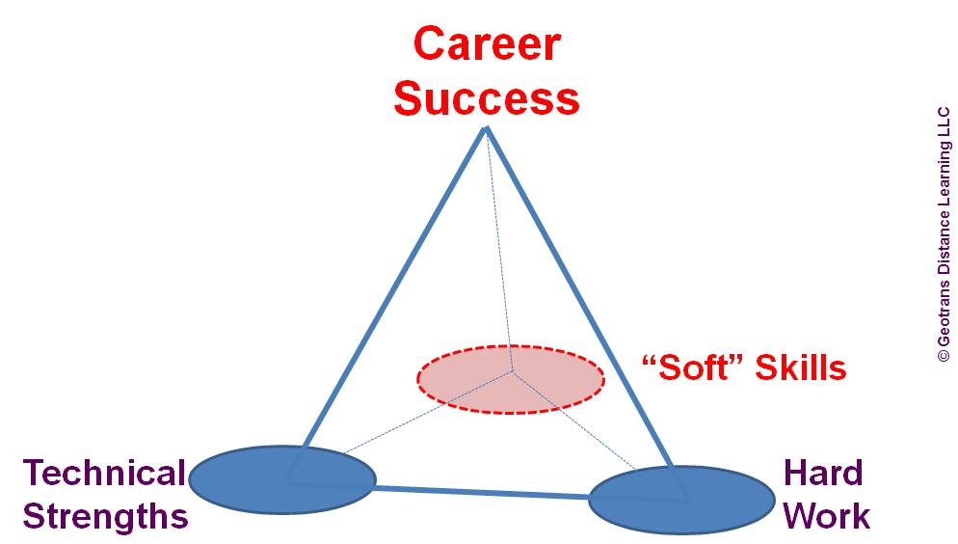

Slide 16
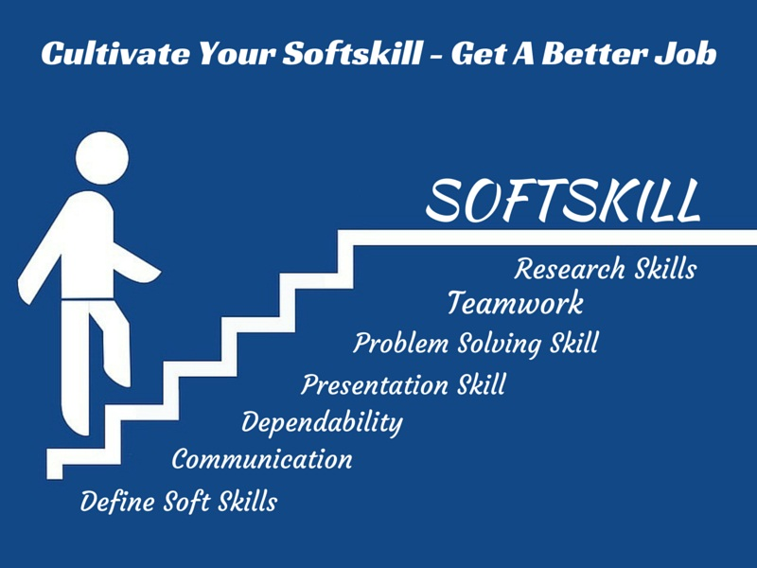
Wisdom is knowing what to do next, skill is knowing how to do it, and virtue is doing it. -David Starr Jordan

